Slide 1
Waste Water Management Case Study – CADS Validation
Niles Guo Water & Energy Efficiency for the Environment (WE³ lab) Engineering & Public Policy Carnegie Mellon University nilesxug@andrew.cmu.edu

Slide 2
Current Parameters – Decision Variables
Decision Variables
Fracking schedule (binary)
Fresh water and waste water piping (binary)
Water transportation volume (continuous)
Via truck
Via piping
To disposal
To central storage
To reuse
Notes:
Scheduling is not binary (ordinal)
Set by leasing schedule (set)

Slide 3
Current Parameters – Fixed Inputs
Fixed Inputs
Gas production
Water demand
Waste water production
Well locations
Cost parameters (transportation cost, piping cost, health/environmental cost etc.)
Notes:
Gas quality (BTU)

Slide 4
Current Parameters - Constraints
Constraints
TDS limit
Number of fracking crew
Policy scenarios (location limitation, traffic limitation etc.)
Pipe size

Slide 5
Who are the decision makers and what are their responsibilities?
Senior Management
Well location
Fracking scheduling
Number of fracking crew
Profit/revenue goal

Slide 6
Well-pad operator
Well-pad operator
Water demand, waste water production, quality of water
Gas production, # of stages, well lifespan
Waste water storage
Freshwater impoundment

Slide 7
Waste water treatment expert
Waste water treatment expert
Treatment technology used
Scalability, cost, and TDS limit
Disposal option (reuse, central storage, disposal site)
Reuse opportunity and value

Slide 8
Freshwater expert
Freshwater expert
Water availability
When
Where
How much to transport
Discharge threshold

Slide 9
Transportation expert
Pipeline parameters
Cost
Feasibility
Pipeline connections
Size
Trucking parameters
Cost
Feasibility
Road connections
Type of truck (volume of truck)

Slide 10
Regulatory actor (?)
Regulator actor
Provide many of the overall scenario parameters
Can waste water be reused?
Discharge requirements
Rates of disposal for each disposal site
Rates of trucking (for community noise restrictions for example)
Connection constraints (no pipeline between certain connections for example)
Notes:
multi-objective ranking
Go through the MML process
Answer the objective: economic analysis
Figure out this is relevant and viable
Set limit on some

Slide 11
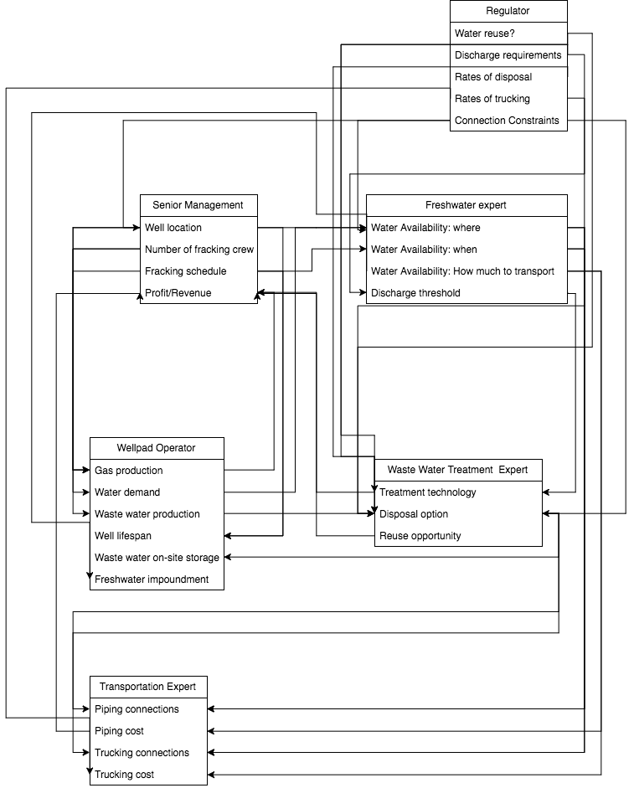
Decision maker flow diagram

Slide 12
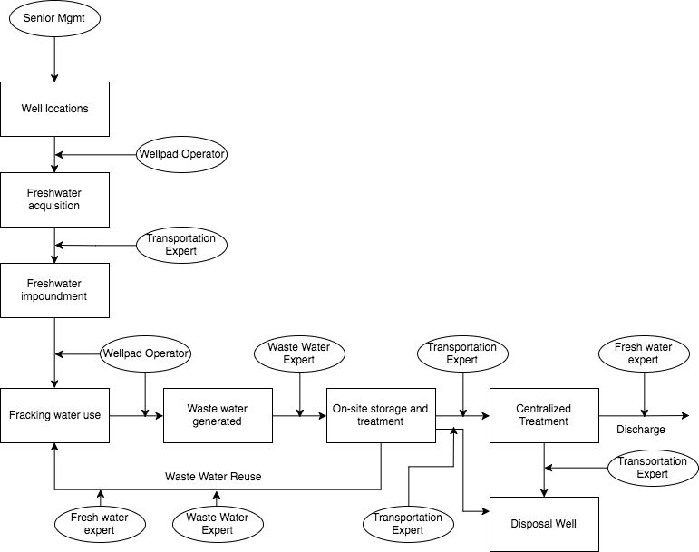
Water flow process diagram

